Slide 1

Building an Algorithmic Trader
Presented by Team “The Survivors” – Peter, Mandy, Steven, Ragini, Nathan

Slide 2

Project Approach
Analyze a fintech problem and develop an application that solves a real-world tech problem.
The scope of the project is to develop a tool to compare trading strategies to inform personal investment portfolios.
To fully realize the application, the group studied several trading strategies and chose three of them to chart out.
These strategies include:
Donchian’s Four Week Rule,
Dreyfus’s 52-Week Rule,
Golden Cross 20 v200 SMA.
Several sectors traded on the stock exchanges were compared and visualized.
The code was written was tested against the data to determine the most successful strategies historically

Slide 3
Goals and Objectives
Learn about successful Trend Trading Methodologies
Research and download varying APIs
Research Sector Exchange Traded Funds (ETFs)
Writing Python code using Jupyterlab, Pandas, yfinance, Plotly
Test code against data to determine which methodologies are most successful historically
Create the basic structure for an Algorithmic Trader

Slide 4
Tested against the SPY
Potential to test strategies against anything with the ticker symbol
Individual stocks
Sector ETFs
Investigated what we can test these strategies against
Potential to test against different sectors
Strategies Used for testing

Slide 5

Data collection & cleaning
Data collection involves various CSV files from various sources:
Pandas data reader library
Yahoo finance
Investigated the alpaca market. However, didn’t use it due to historical data restrictions (3-5 years only)
Downloaded stock data which were already cleaned
Additional data was generated and cleaned

Slide 6
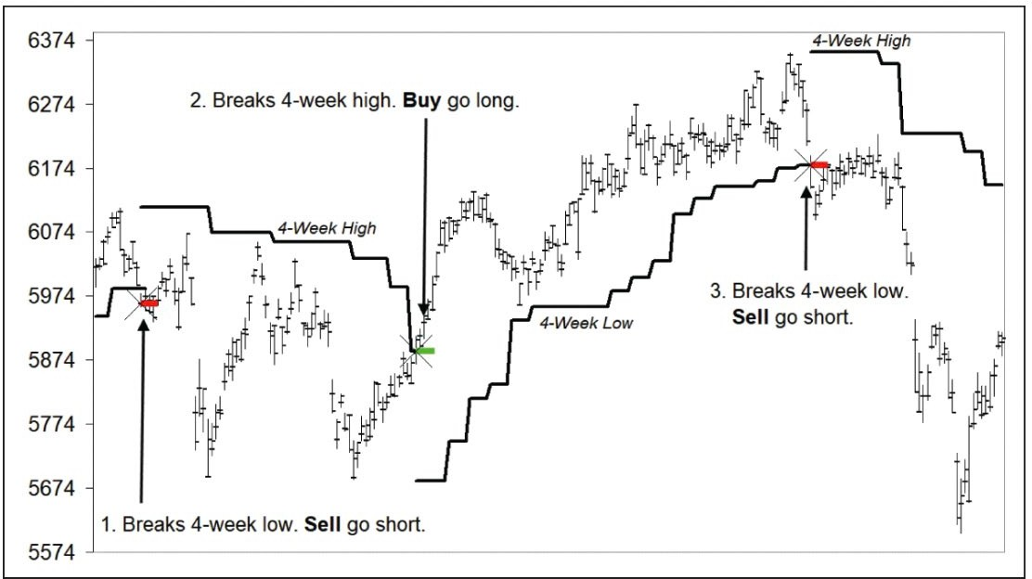
DONCHIAN’S 4 WEEK RULE
Follows a four-week break-out.
If model is short and market takes out highest weekly high, exit and reverse going long.
If the model is long and the market takes out the lowest weekly low, exit and reverse going short

Slide 7
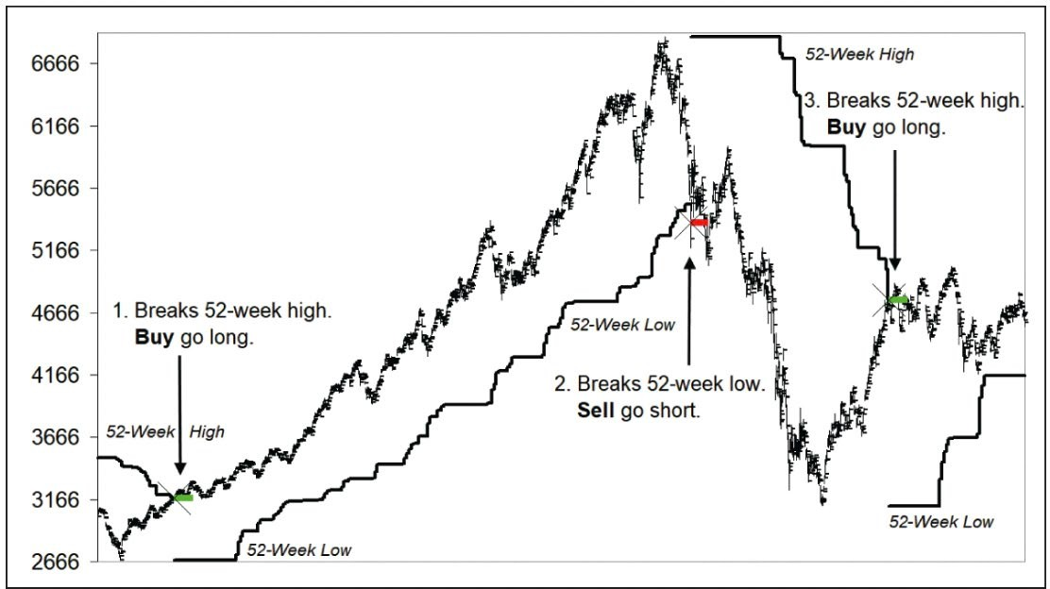
DREYFUS’S 52 WEEK RULE
Similar to Donchian’s four-week rule.
Follows 52 weeks highs and lows.
If model is short and market takes out highest weekly high, exit and reverse going long.
If the model is long and the market takes out the lowest weekly low, exit and reverse going short

Slide 8
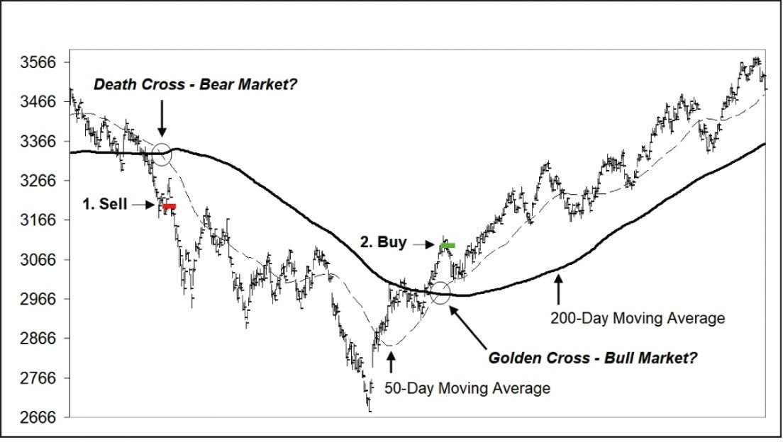
GOLDEN CROSS
A popular strategy that frequently appears in the media by ‘talking heads’
Sometime 50 v 200-day SMA crossover
Used 20 v 200 SMA
Model goes long when fast SMA crosses slow SMA to the upside.
Model goes short when fast SMA crosses slow SMA to the downside.

Slide 9
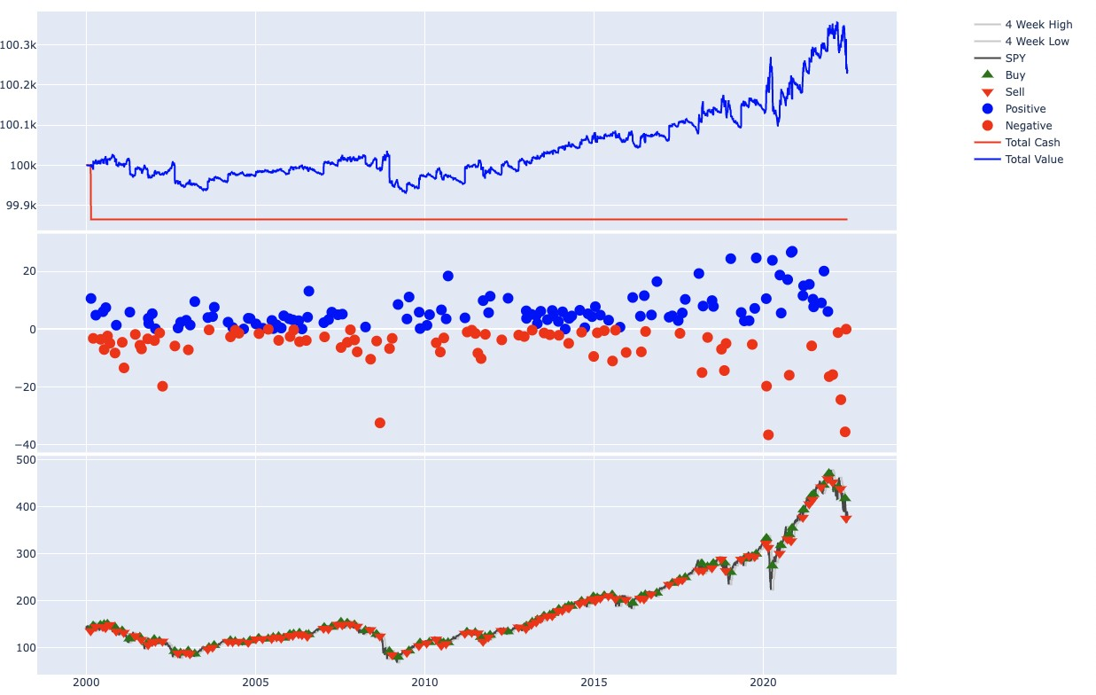
Donchian’s Four Week

Slide 10
Dreyfus’ 52 Week

Slide 11
Golden Cross 20v200 SMA

Slide 12
APIs We Used
Plotly
We took Kyle’s advice; used Plotly to implement a visual representation of the output of our strategies
yfinance
This library let us download the historical data from https://finance.yahoo.com/
pandas_datareader (pdr)
We discovered this library later and replaced the yfinance API
pdr can be used to download historic stock data from many different services/APIs

Slide 13
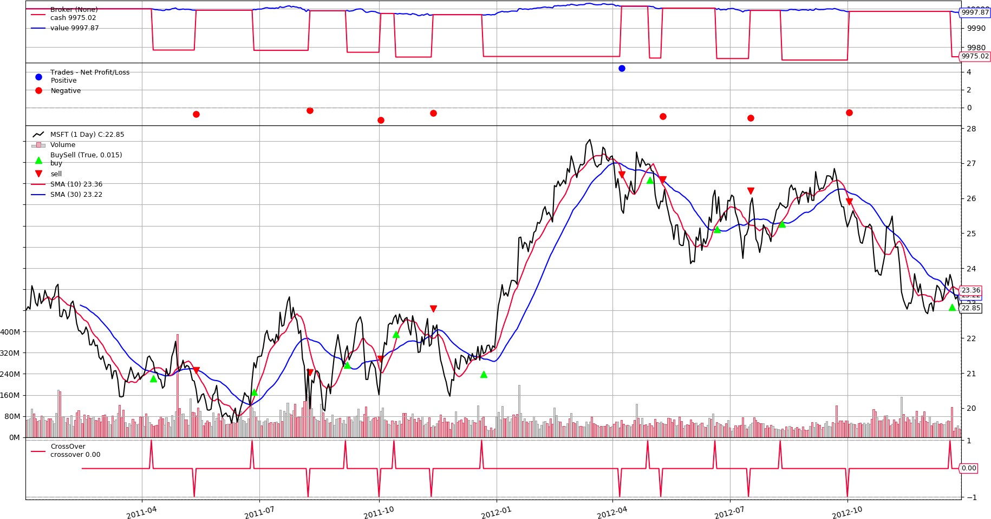
APIs We (Almost) Used
Alpaca
Initially tried downloading data from ALPACA; abandoned because historic stock data is limited to ~ 4 years
Backtrader
A feature-rich Python framework for backtesting and trading; can be used to write reusable trading strategies, indicators and analyzers.
Abandoned because the framework uses object- oriented programing (aka classes)
Difficult to implement some trading strategies
backtesting.py
Similar to backtrader; required further investigation

Slide 14
Data Collection
Data Collection
Historic stock data is quite prevalent - most difficult choice is where to source the data. We started with Alpaca, and then settled on yfinance and later pandas_datareader for ease-of-use of their APIs. Settled on pandas_datareader for the future ability to download data from sources other than Yahoo Finance.
Data Cleaning
Historic stock data is pretty clean to begin with - biggest thing to watch out for are differently spelled column names, and their order. Difficulty was mostly avoided by downloading data from a single source.

Slide 15
Strategy Implementation
Originally planned to use Backtrader API to generate Technical Indicators (4 Week High, 20- day SMA, etc.) and create reusable Trading Strategies we could run on historic stock data.
When generating custom Technical Indicators became too difficult we decided to pivot.
By pivoting we swapped the difficulty of learning a new API, with manually generating trading data.
Manually generating Technical Indicators for Trading Strategies with simple rules is relatively easy
We used Pandas .rolling(period_size) function combined with .max(), .min(), and .mean() functions to generate the Rolling High/Low, or Fast/Slow SMAs we required.
At it’s most basic, a trading strategy is a conditional statement that executes a Buy or Sell
If one Technical Indicator (TI) is > (greater than) another TI, execute a Buy
If one TI is < another TI, execute a Sell
Etc.
To support this, we built a simple framework to “trade” a stock…

Slide 16
Application Framework
app.py
Holds all import statements, initializes core variables, and runs the program from start to end (plotting a graph). broker.py
Initializes a simple broker; has create_orders(), process_orders(), and execute_orders() functions
The execute_orders() function supports Buy, Sell, and Close order types
Stores all Orders and Position data generated for later use when plotting the results strategies.py
Holds a function for each strategy we created
Each strategy executes appropriate broker functions at the appropriate time utils.py
A set of helper functions for downloading, loading, and saving stock data. plots.py
Plots the output of the strategy and stock data selected

Slide 17

Conclusions
Building an algorithmic trader is not easy
Third party APIs are only as useful as their documentation
Algorithms are dumb. Humans are smart
My level of knowledge is limited and code is only as good as people’s ability to use it
Trend trading is always going to be gambling, no matter how you spin it
We don’t want another group next time, we want the same group

Slide 18

Next Steps
Implement Questionnary and a main() loop so users can enter which stocks they want to download or use, and select the strategy to run.
Drink beer.

